Slide 1
Smart stick for blind
Name : Asraful Islam Kajol
ID : 18101082
Section: B2

Slide 2
Context
Introduction
How it works
Components
Proteus design
Arduino code

Slide 3
Introduction
The smart blind stick automatically detects the obstacle in front of the person and give him a response to the person by vibrating the stick and also with a warning sound. Through this smart stick the blind person can be aware of the obstacles in front of him.

Slide 4
How It Works
In my project the ultrasonic sensor collect data by frequency to measure the distance.
Blind people can press the button to on the sensor.
If the distance is below 100cm then buzzer and vibrator motor will be on.

Slide 5
Components
Arduino UNO R3
Ultrasonic Sensor
Push Button
Buzzer
Jumper Cable
Shaftless Vibration Motor
Battery
Battery to 2.1mm Wire Cap

Slide 6
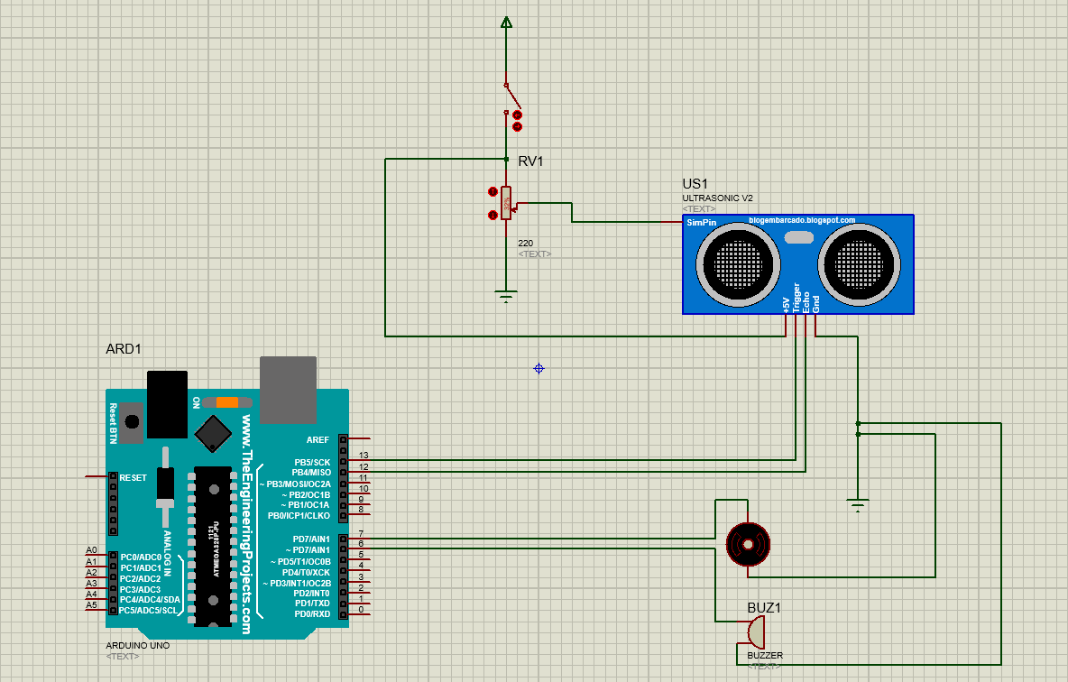
Proteus Design

Slide 7
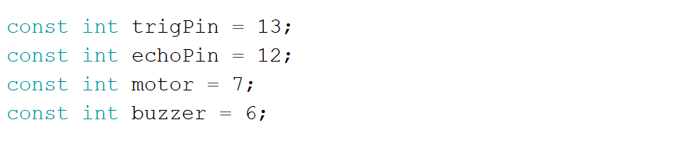
Arduino Code

Slide 8
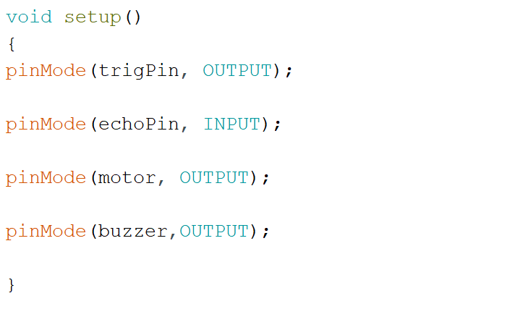
Arduino Code (Contd.)

Slide 9
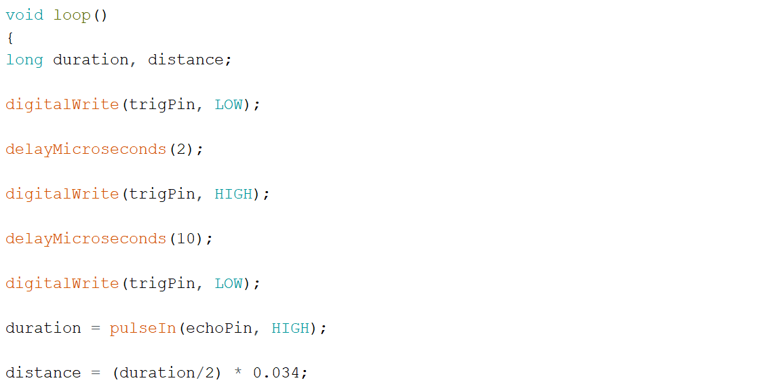
Arduino Code (Contd.)

Slide 10
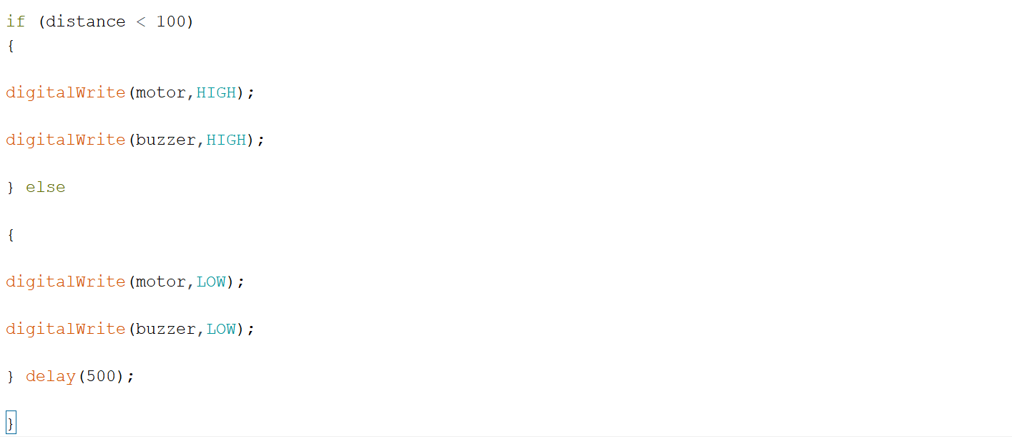
Arduino Code (Contd.)

Slide 11


Slide 12


